Slide 1
Number Systems

Slide 2
To be Discussed
Base or Radix.
Binary Numbers.
Octal Numbers.
Hexadecimal Numbers.

Slide 3

Number System
We express a number in any base or radix, X.
For binary, the base is 2.
For Decimal, the base is 10
For Octal, the base is 8
For Hexadecimal, the base is 16
1 0 0 1 0 1 0 0 0 0 1 1 0
MSD
LSD

Slide 4


Slide 6
Binary System
Only two digits (or bits) - 0 and 1.
The position of 0 or 1 in a number indicates its “weight”.
1 0 0 1 0 1 0 0 0 0 1 1

Slide 7

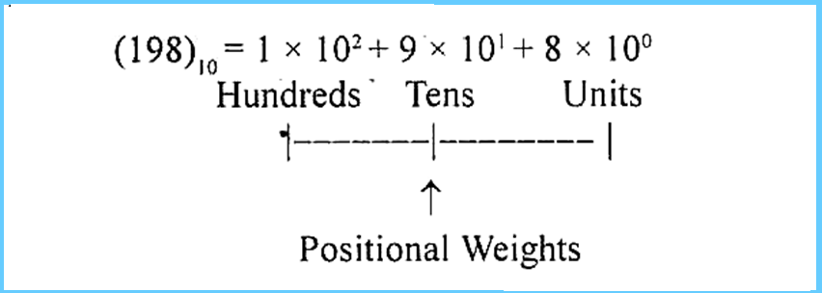

Slide 8
Decimal to Binary Conversion
2 | 125
 | 62 | 1
 | 31 | 0
 | 15 | 1
 | 7 | 1
 | 3 | 1
 | 1 | 1
Binary Conversion is: 1111101

Slide 9
Decimal to Binary Conversion
Q. Convert 49 to Binary Number
2 | 49
2 | 24 | 1
2 | 12 | 0
2 | 6 | 0
2 | 3 | 0
 | 1 | 1
Binary Conversion is: 110001

Slide 10
Decimal to Binary Conversion: 45
2 | 45
2 | 22 | 1
2 | 11 | 0
2 | 5 | 1
2 | 2 | 1
 | 1 | 0
Binary Conversion is: 101101

Slide 11
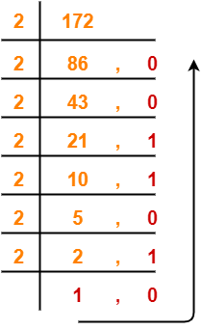
Decimal to Binary Conversion
45 and 172
Binary Conversion is: 10101100

Slide 12
Binary to Decimal Conversion
(110001) 2 = (?) 10
1 | 1 | 0 | 0 | 0 | 1
2^5 | 2^4 | 2^3 | 2^2 | 2^1 | 2^0
32 | 16 | 8 | 4 | 2 | 1
32 | 16 | 0 | 0 | 0 | 1
(32+16+1)=49

Slide 13
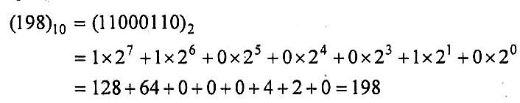
(11000110)2=(?)10
A group of 4 and 8 bits is called a nibble and a byte respectively.

Slide 14
Decimal to Binary with Fraction Conversion
Double-dabble method :
Example : Convert (53.625)₁₀ into binary.
Take integer and fraction part separately.

Slide 15
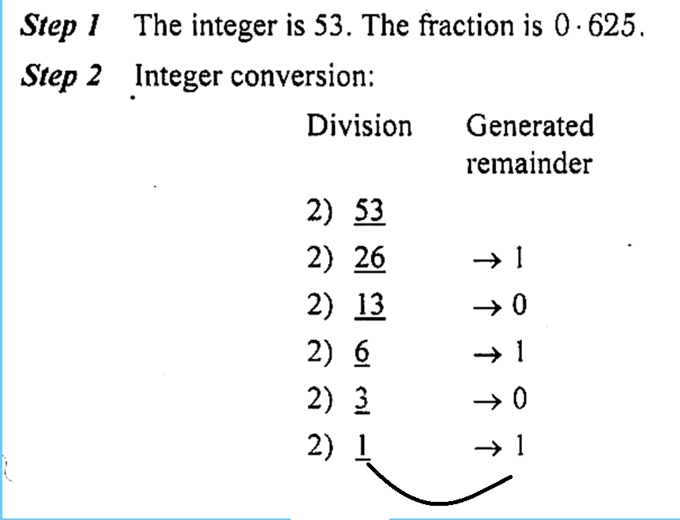

Slide 16
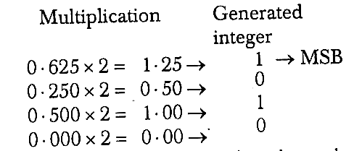
Hence, (53.625)₁₀
= (110101.1010)₂
_{(125.250)=}
_{1111101.010}

Slide 17
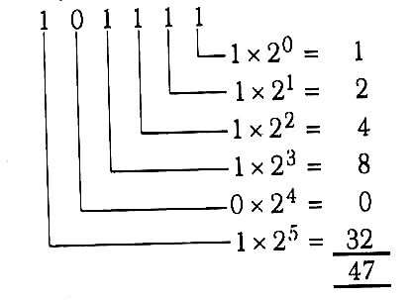
Binary to Decimal with Fraction
Example: Convert (101111.1101)₂ into its decimal equivalent.
First, the integer part :

Slide 18
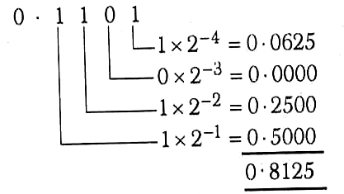
Similarly, the fraction part :
Hence, (110101.101)₂
= (47.8125)₁₀

Slide 19
Thank You!!!

